Slide 1

Presentation for the Front-end Part
3 mins per group

Slide 2

1. Member
** project leader
(who will upload this presentation to the Moodle )
1. Name ID Sec. <<wangyuzhe 20232054>>(leader)
2. Name ID Sec. <<wangpengyue 20232097>>
3. Name ID Sec. <<liuwenhao 20232081>
** poject leader

Slide 3
2. Project name/Project Goal
Project name: <<unipue>>
Project goal: <<Enable public opinion news management and comment features>>

Slide 4
3. Features
F1 - Home: news list, filter (All/Fake/Not Fake), items-per-page selection, pagination
F2- Detail: full news info (topic, body, status, reporter, time, image URL), vote stats, comment pagination
F3- Vote Page: standalone vote page, supports comment and image link (URL)
F4- Decision Rule: majority decides “Fake/Not Fake”; tie = “Pending”
F5- Storage: Pinia manages front-end state only; no server POST. Refresh clears newly added comments.

Slide 5
4. Tech Stack
- Vue 3 + Vite
- Vue Router
- Pinia (front-end state management)
- Vercel static deployment

Slide 6
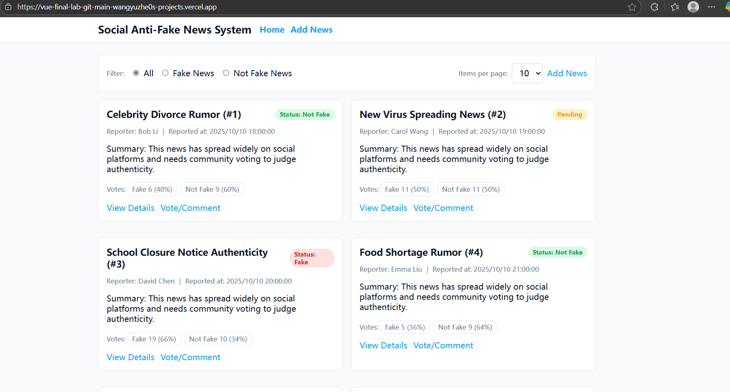
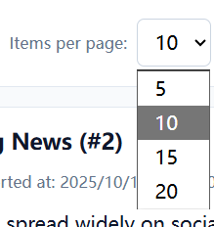
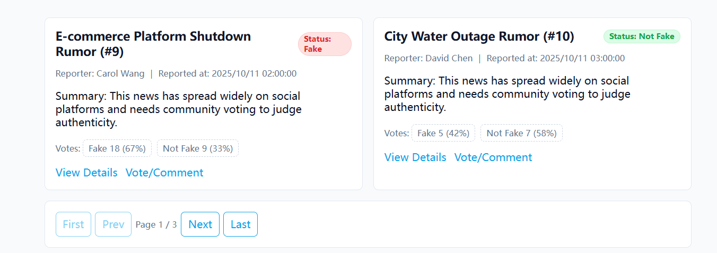
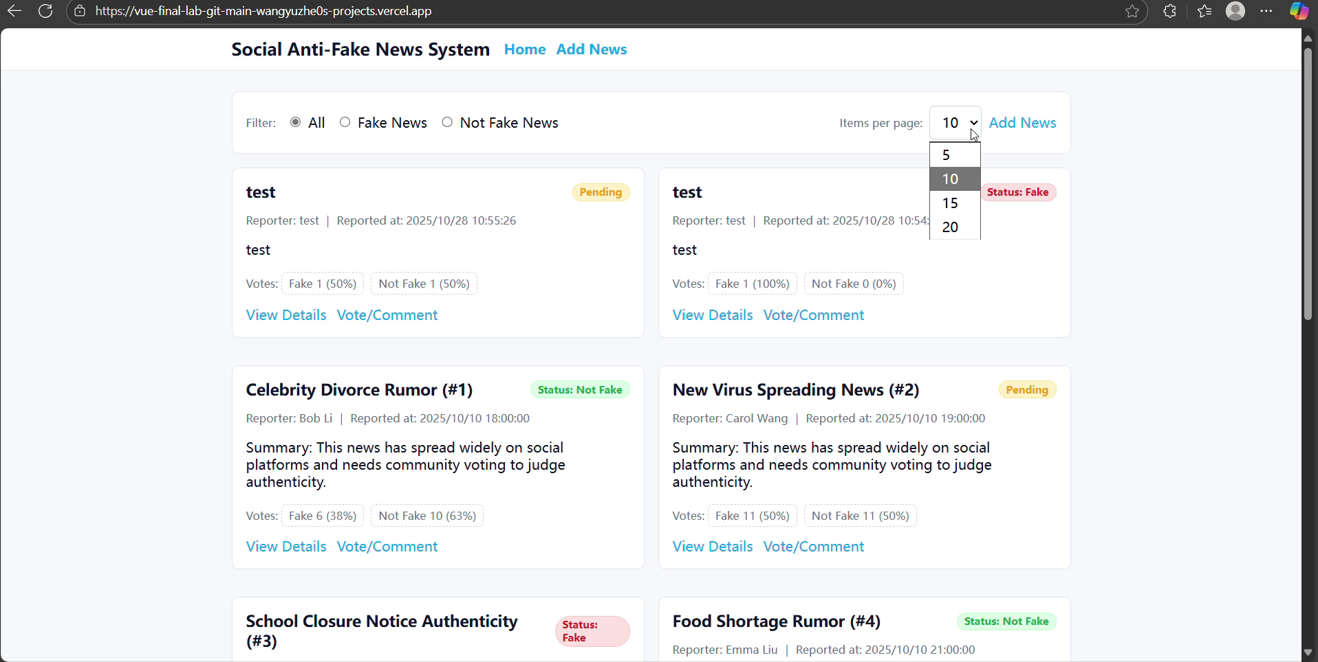
5. Home page
we can choose the number of news items to display on each page. You can jump to the next page at the bottom of the page.

Slide 7
demonstration video

Slide 8
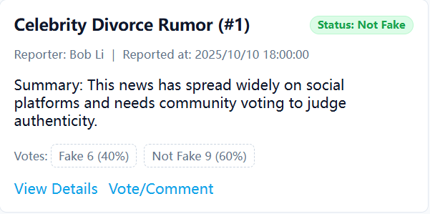
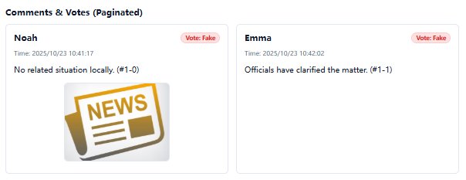
6. News Details Page
- Click on one news item to show: topic, full details, reporter, date/time, image (URL) - Show comment section and voting results (fake / not fake)

Slide 9
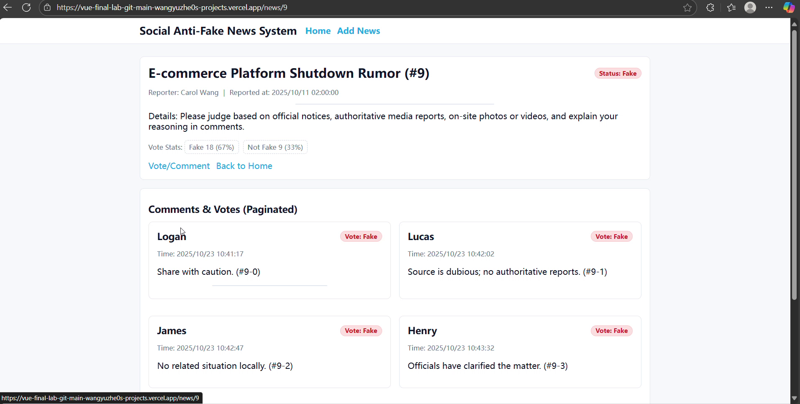
demonstration video

Slide 10
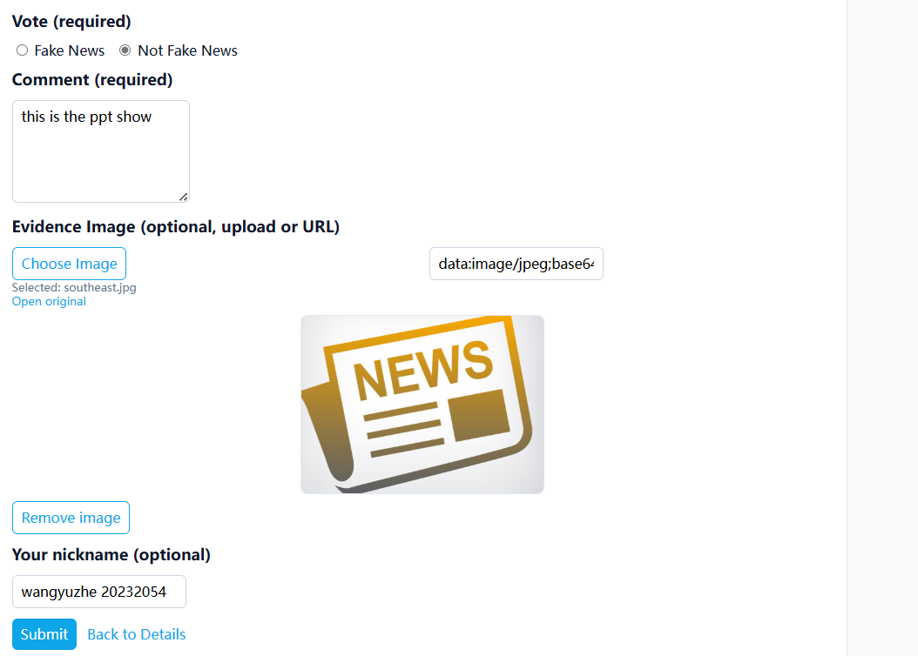
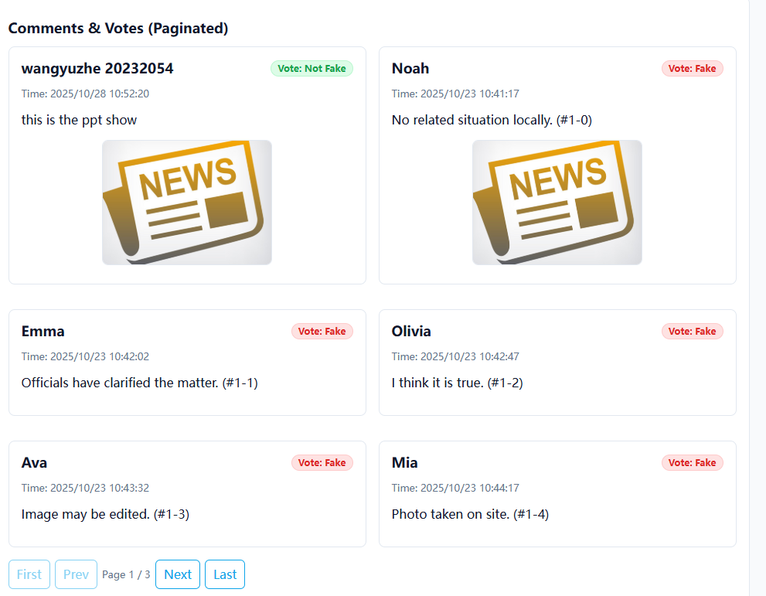
7. Vote & Comment Feature
- Demonstrate voting and adding a comment or image link - Show that new data appears in the comment list immediately

Slide 11
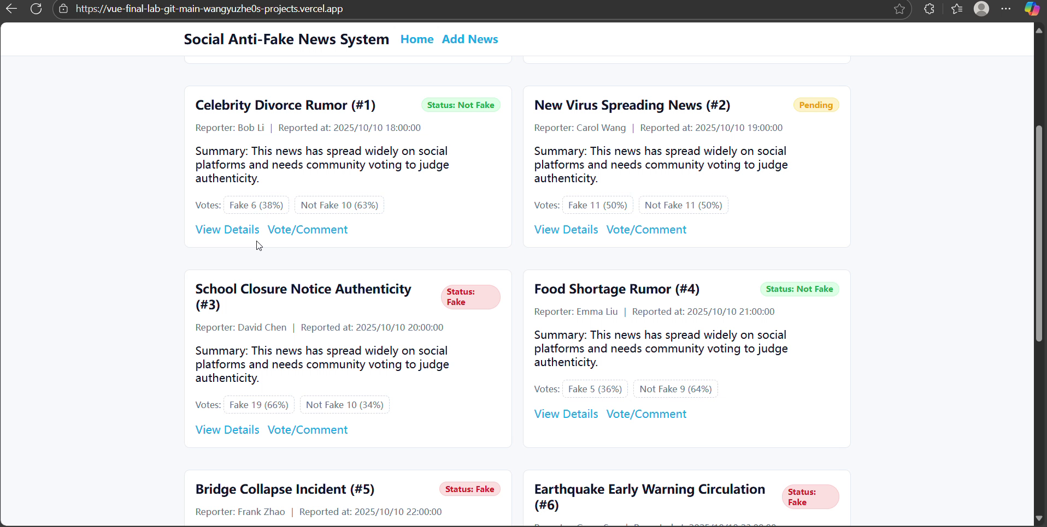
demonstration video

Slide 12
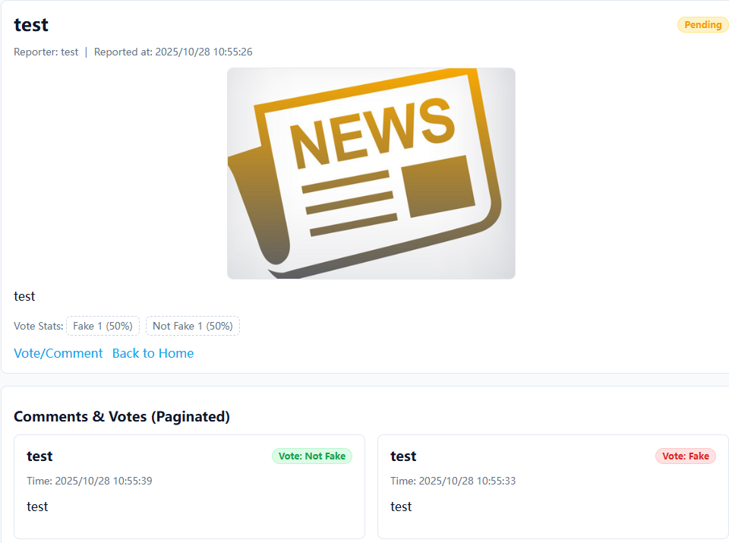
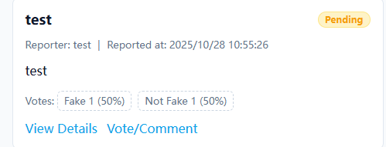
8. Deployment with Versel
- Mention mock data used for testing and pagination implemented

Slide 13
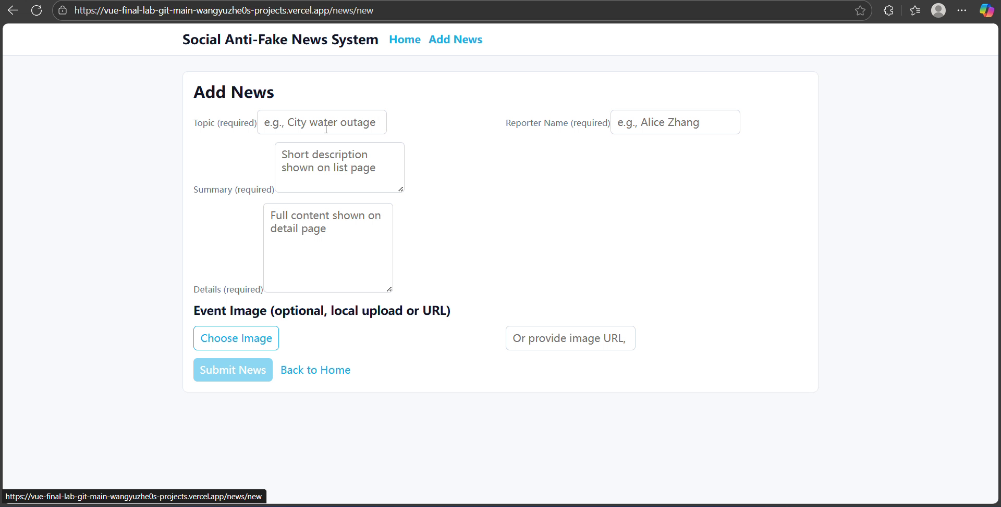
demonstration video

Slide 14
Submission
Record 3-5 mins presentation and submit to Moodle (Only one people in the team will submit in Moodle, you can submit to any section)
Submission Deadline : 9th November 11.59 pm

Slide 15
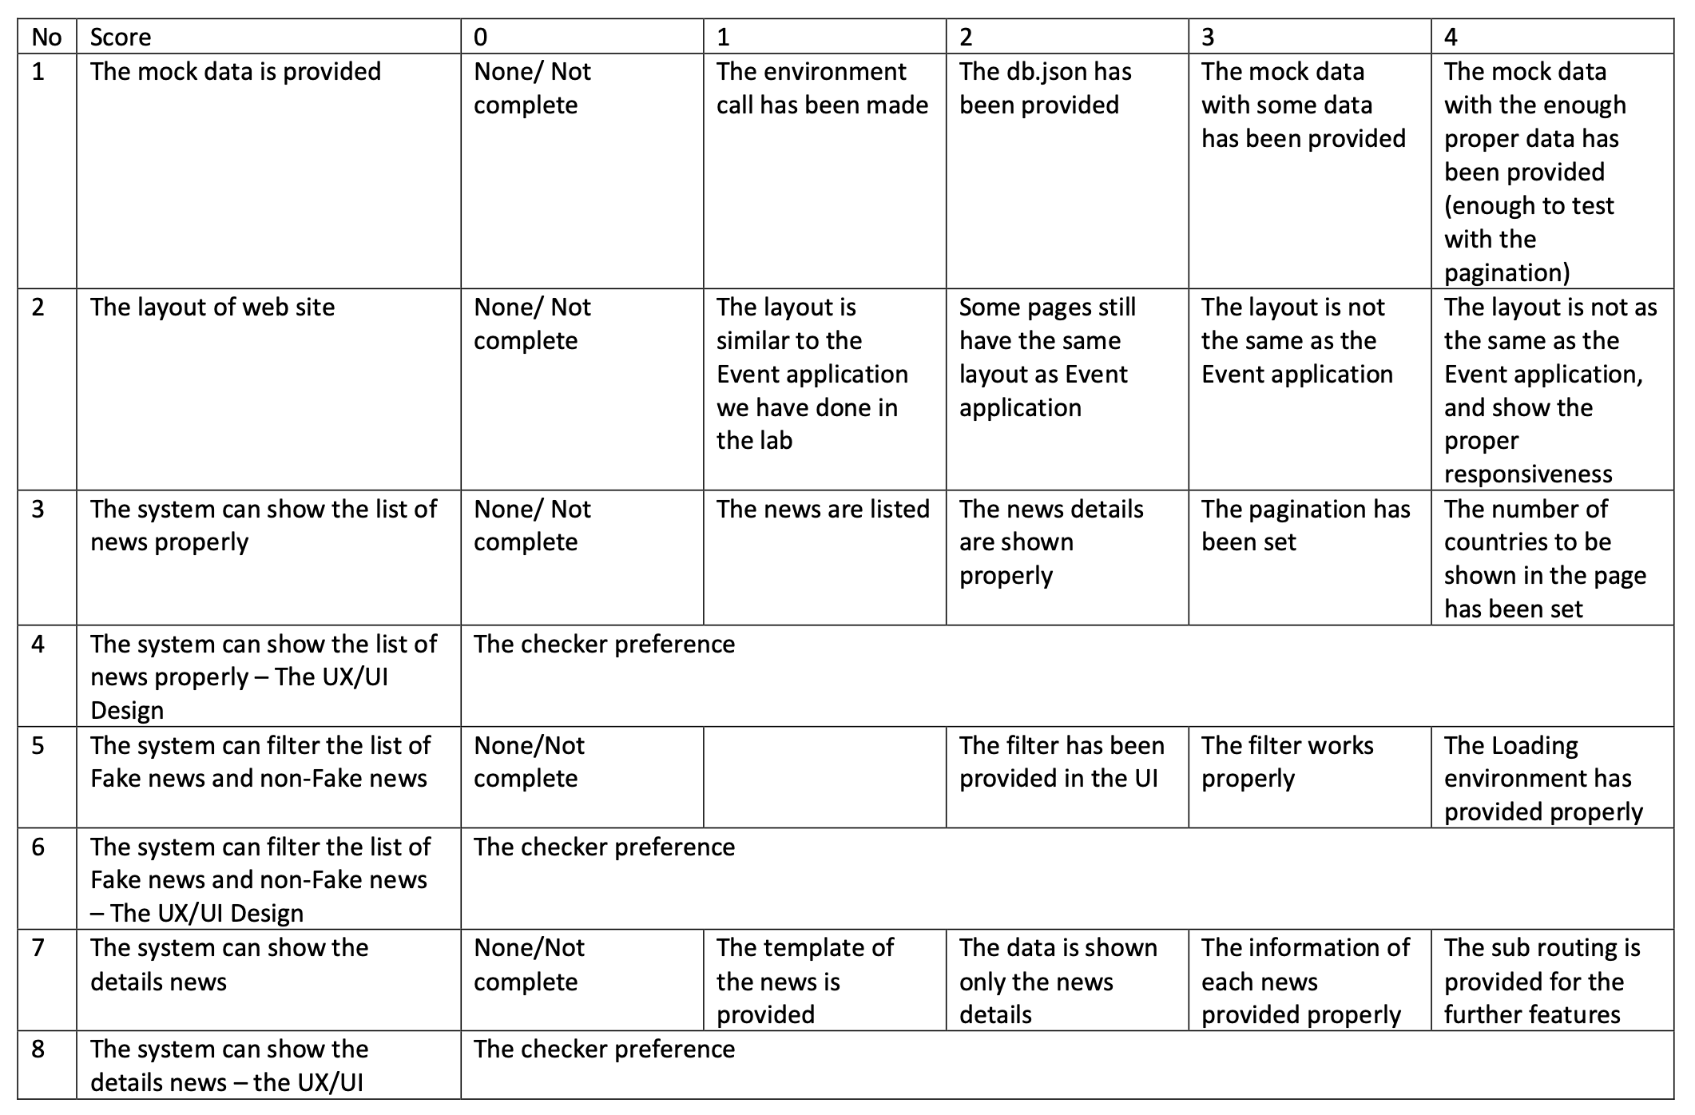

Slide 16
